Slide 1
Communication Skill
Notes:
1

Slide 2
Learning Outcome
Define and understand communication and the communication process
List and overcome the filters/barriers in a communication process
Practice active listening
Tips to improve communication

Slide 3

What is Communication?
Communication is the art of transmitting information, Ideas and attitudes from one person to another.
Communication :
The Personal Process
Involves change in Behavior
Means to influence others
Expression of thoughts and emotions through Words and actions .
Quote: The quality of your Life is the quality of your communication both with yourself and others.

Slide 4
Communication
7% WORDS
  Words are only labels and the listeners put their own interpretation on speakers words
38% PARALINGUISTIC
  The way in which something is said - the accent, tone and voice modulation is important to the listener.
55% BODY LANGUAGE
  What a speaker looks like while delivering a message affects the listener’s understanding most.

Slide 5
What are the most common ways we communicate?
Visual Images
Spoken Word
Written Word
Body Language

Slide 6
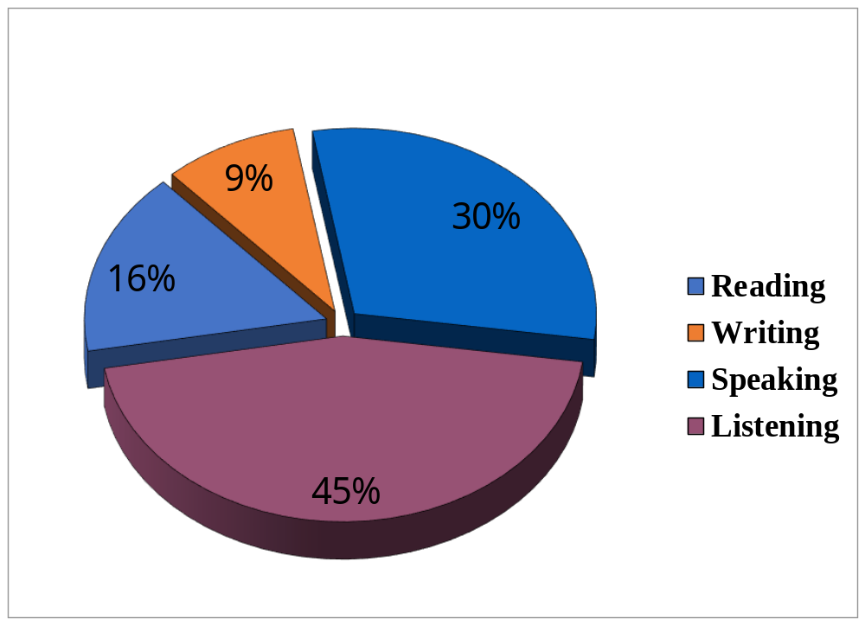
TOTAL COMMUNICATION PROCESS

Slide 7
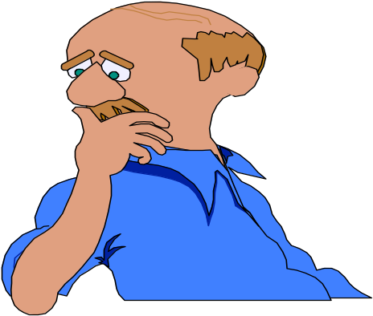
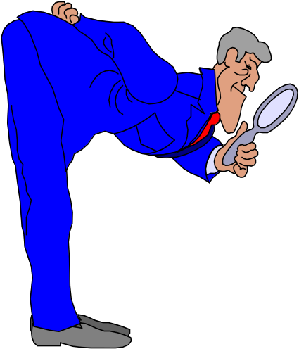
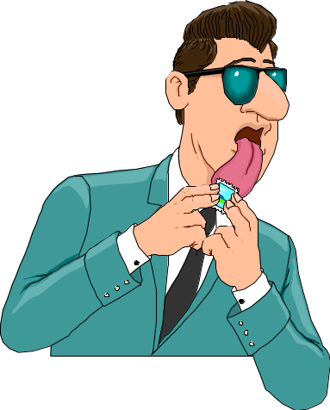
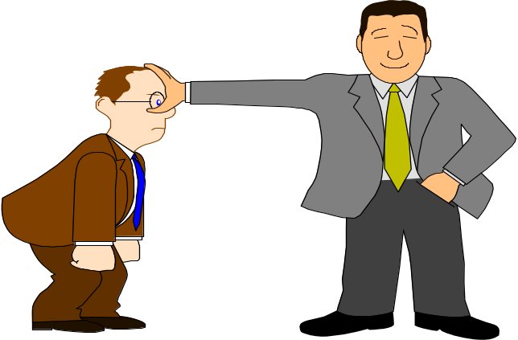
Communication is a Series of Experiences of
Hearing
Smell
Seeing
Touch
Taste

Slide 8
Why Communication
Inspires confidence
Builds respect
Helps make friends
Reveals your ability to others
Develops a distinct personality

Slide 9
Types of Communication- Based on Hierarchy
Downwards Communication : Highly Directive, from Senior to subordinates, to assign duties, give instructions, to inform to offer feed back, approval to highlight problems etc.
Upwards Communications : It is non directive in nature from down below, to give feedback, to inform about progress/problems, seeking approvals.
Lateral or Horizontal Communication: Among colleagues, peers at same level for information level for information sharing for coordination, to save time.
In modern business environment communication extends beyond written or spoken words to listened word.
Visual dimension added by T.V., computers has given to new meaning to
Communication.

Slide 10
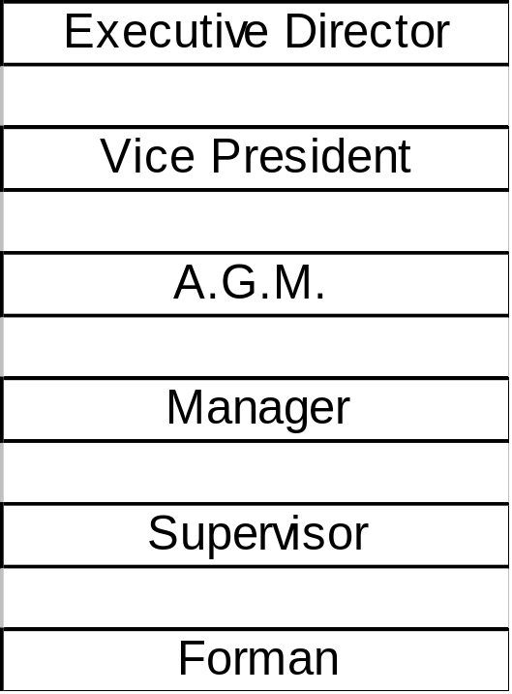
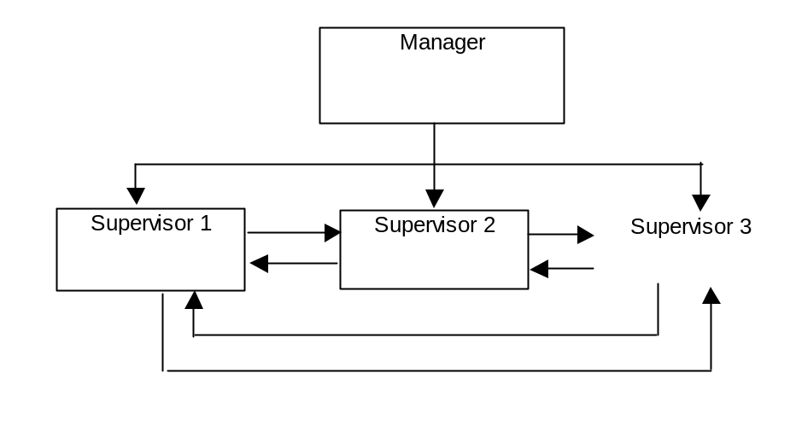
HIERARCHY LEVEL
Downward comm.
Upward comm.
Horizontal Comm.

Slide 11
COMMUNICATION NETWORKS
Formal Network: Virtually vertical as per chain go command within the hierarchy.
Informal Network : Free to move in any direction may skip formal chain of command. Likely to satisfy social and emotional needs and also can facilitate task accomplishment.

Slide 12
CHANNELS OF COMMUNICATION
 | VOCAL | NON-VOCAL
VERBAL | SPOKEN WORDS | WRITTEN WORDS
NON-VERBAL | SIGH | FACIAL EXPRESSION
 | GRUNT | POSTURE / GESTURE
 | INFLECTION | SPATIAL RELATIONSHIP

Slide 13
Types of Nonverbal Communication
Body Language: Kinesic behavior,-body motion such as gestures, facial
expressions, eye behavior, touching,- Body movement.
Space
Time
Para language: Voice quality, volume, speech rate, pitch, &
laughing.
Color
Layout and Design

Slide 14
The Communication Process
Medium
Barrier
SENDER
(encodes)
Barrier
RECEIVER
(decodes)
Feedback/Response

Slide 15
CHANNELS OF COMMUNICATION
Face to Face
Interactive TV - high speed connections (two way)
Video-Voice / Data Channel (one way)
Telephone
E-mail
Personal written correspondence
Formal written message
Public speaking
DataReports
Influence Level
Broadcast e- mails / reports

Slide 16


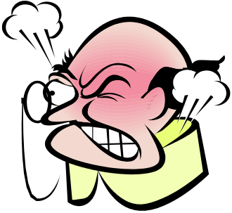

Barriers to communication
Noise
Distractions
Inappropriate medium
Emotions
Language differences
Assumptions/Misconceptions/Prejudice
Poor listening skills/Lack of concentration
Lack of Enthusiasm and Lack of Interest in the Topic/Subject
Lack of Self-Confidence and self awareness
Unwillingness to learn new approaches
Unwillingness to say things differently
Lack of Feedback
Lack of Motivation and Training

Slide 17


Hearing Vs Listening
Hearing – Physical process, natural, passive
Listening – Physical as well
as mental process, active,
learned process, a skill
"There is none so blind as those who will not listen.“……”William Slater”

Slide 18
Listening
Types of Listening | Nature of Listening | Kinds of Listening
Active vs. Passive | Sensing | Appreciative
Positive vs. Negative | Filtering | Empathic
 | Remembering | Discriminative
 |  | Analytical

Slide 19
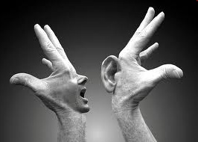
Why Listen
Listening is the most powerful form of acknowledgement……………..a way of saying “ You are important”
Listening builds stronger relationships
Listening creates openness & acceptance
Listening leads to learning

Slide 20
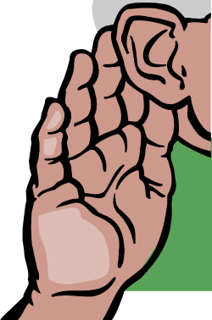
VALUE OF LISTENING
Listening to others is an elegant art.
Good listening reflects courtesy and good manners.
Listening carefully to the instructions of superiors improve competence and performance.
The result of poor listening skill could be disastrous in business, employment and social relations.
Good listening can eliminate a number of imaginary grievances of employees.
Good listening skill can improve social relations and conversation.
Listening is a positive activity rather than a passive or negative activity.

Slide 21
Reasons why we Do Not Listen
Listening is Hard Work
Competition
The Rush for Action/Rush to reply
Speed differences (120 wpm v/s 360 wpm)
Lack of Training/Language
Trying to listen to more than one conversation at a time
Not focusing on what they speak
You make judgements
Previous experiences

Slide 22
More & Less Effective Listening Skills
Active, focused
Passive, laid back
Pays attention
Easily distracted
Asks questions
Asks no question
Keeps open mind
Has preconceptions
Assimilates
information
Disregards
information

Slide 23
Signs of Ineffective Listening
Lack of eye contact with the speaker
An inappropriate posture
Being distracted
Inappropriate expressions and lack of head nods
Daydreaming
Sudden Changes in Topic
Selective Listening
Advising

Slide 24
Comparison of Non-listening & Active Listening
Non-listening
Active Listening
Orientation toward self
Little use of mind (thinking)
Lack of etiquette
Inattention to principles of effect
No consideration
Little empathy
Casual attention to meaning
Emphasis on winning
Inattention to nonverbal communication
Results in conflict
Orientation toward others
Significant use of mind
Good application of etiquette
Effective use of principles of effect
Consideration of alternate messages
Much empathy
Intense attention to meaning
Emphasis on understanding
Much personal involvement
Focus on nonverbal communication
Results in rapport

Slide 25
Methods to improve Listening Skills
Stop Talking. Relax and Prepare Yourself to Listen
Leaning slightly forward if sitting
Maintaining appropriate distance
Minimize Interruptions
Be Patient- Don’t rush to reply
Being Open Minded & Non Defensive
Avoid Personal Prejudice/Avoid judging
Listen to the Tone
Hold your temper
Wait and Watch for Non-Verbal Communication
Empathise if it require- Try to think from the other person’s end.

Slide 26
ESSENTIALS OF COMMUNICATION
Dos
Always think ahead about what you are going to say.
Use simple words and phrases that are understood by every body.
Increase your knowledge on all subjects you are required to speak.
Speak clearly and audibly.
Check twice with the listener whether you have been understood accurately or not
In case of an interruption, always do a little recap of what has been already said.
Always pay undivided attention to the speaker while listening.
While listening, always make notes of important points.
Always ask for clarification if you have failed to grasp other’s point of view.
Repeat what the speaker has said to check whether you have understood accurately.

Slide 27
ESSENTIALS OF COMMUNICATION
DON’Ts
Do not instantly react and mutter something in anger.
Do not use technical terms & terminologies not understood by majority of people.
Do not speak too fast or too slow.
Do not speak in inaudible surroundings, as you won’t be heard.
Do not assume that every body understands you.
While listening do not glance here and there as it might distract the speaker.
Do not interrupt the speaker.
Do not jump to the conclusion that you have understood every thing.

Slide 28

How to Improve Existing Level of
COMMUNICATION?
IMPROVE LANGUAGE.
IMPROVE PRONUNCIATIOON.
WORK ON VOICE MODULATION.
WORK ON BODY LANGUAGE.
READ MORE
LISTEN MORE
AVOID READING OR WATCHING OR LISTENING UNWANTED LITERATURE, GOSSIP, MEDIA PRESENTATION ETC.
INTERACT WITH QUALITATIVE PEOPLE.
IMPROVE ON YOU TOPIC OF DISCUSSION,
PRACTICE MEDITATION & GOOD THOUGHTS.
THINK AND SPEAK.
DO NOT SPEAK TOO FAST.
USE SIMPLE VOCABULARY.
DO NOT SPEAK ONLY TO IMPRESS SOMEONE.
LOOK PRESENTABLE AND CONFIDENT.

Slide 29
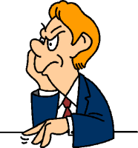
Improving Body Language - Tips
Keep appropriate distance
Touch only when appropriate
Take care of your appearance
Be aware - people may give false cues
Maintain eye contact
Smile genuinely

Slide 30
Inspirational Quotes
When you use a Positive word, a wave of Positive word, engulfs you, raising your Energy Levels & Putting you in a “Winning Frame of Mind.”
"He who wishes to talk well must first think well.”
"When you speak, your speech should be better than your silence would have been.“
"Great speakers are not born, they're trained."
-- Dale Carnegie
"Perhaps you will forget tomorrow the kind words you say today, but the recipient may cherish them over a lifetime.“ Dale Carnegie

Slide 31
Inspirational Quotes
"Communication is really all anyone ever gets paid for ultimately...and if you cannot effectively communicate...you will PAY...not get paid..." -- Doug Firebaugh
"Kind words can be short and easy to speak, but their echoes are truly endless.“ …Mother Teresa

Slide 32
Framing Messages
Change the following negative messages to a more positive I/We message.
Negative
Positive Approach(Assignment for the participant)
You never call me.
You don’t listen to me!
Everyone here hates me!
That’s a dumb idea.
No one does anything here.
You annoy me, go away!
Leave me alone!
You lied to me.
Who invited you!
You did a horrible job.
You make me so mad.
You are so inconsiderate!
I won’t / I can’t
You must
They won’t allow that
I wish you called me more often
Sometimes I feel I am not being listened to.
I sometimes feel people dislike me.
Maybe we could try a different idea.
Let’s all work hard together.
I am disturbed, could we talk later.
I need some time to myself right now.
I don’t think that I was told the complete truth.
Glad you are coming.
I think you can do a little better.
I get angry at you sometimes when you…
Sometimes I think you don’t consider how I feel.
I will/I can
Could you please…
Let me check the possibility…
Note: All answers are not shared, few kept for assignment purpose for the participant

Slide 33

Key Phrases
I understand.
I’m sorry.
Please
Thank you.
You’re welcome.
I can help you …
I understand you’re upset / however … (next question)
My supervisor can help you.
Let me help you
Good question! I can find out.
Sure

Slide 34
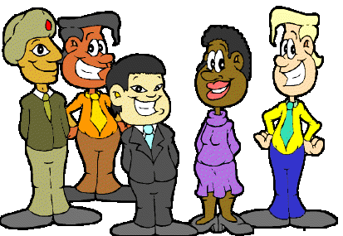
Success for YOU…
The new global and diverse workplace requires
excellent communication skills!

Slide 35


